Slide 1
RabbitMQ with Spring boot

Slide 2
Agenda
What is Messaging Queue, How it works and its uses
What is Rabbit MQ
Different types of Exchanges in Rabbit, MQ
What is Messaging Queue, How it works and its uses
Different types of Exchanges in Rabbit MQ .
  Direct Exchanges
  Fanout Exchanges
  Topic Exchanges
  Header Exchanges
Retry and Error Handling Example

Slide 3
What is RabbitMQ ?
What is RabbitMQ ?
  RabbitMQ is a message broker that originally implements the Advance Message Queuing Protocol (AMQP)
AMQP standardizes messaging using Producers, Broker and Consumers.
  AMQP standards was designed with the following main characteristics Security, Reliability, Interoperability
  Reliability confirms the message was successfully delivered to the message broker and confirms that the message was successfully processed by the consumer

Slide 4
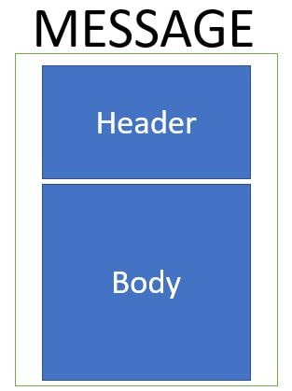
What is Messaging?
Messaging is a communication mechanism used for system interactions. In software development messaging enables distributed communication that is loosely coupled.
A messaging client can send messages to, and receive messages from, any other client. The structure of message can be defined as follows

Slide 5
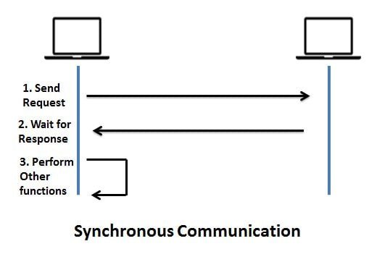
Synchronous Messaging
Synchronous Messaging is implemented when such that the messaging client sends a message and expects the response immediately. So the sender client waits for the response before he can execute the next task. So until and unless the message is recieved the sender is blocked.

Slide 6
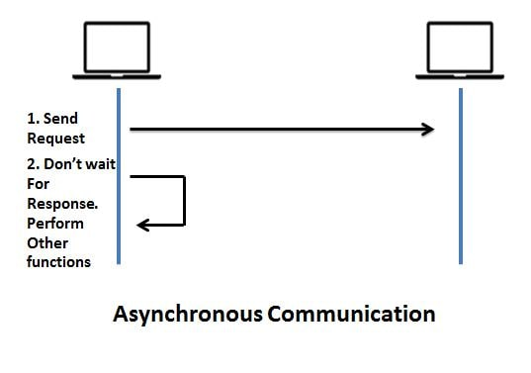
Asynchronous Messaging
Asynchronous Messaging is implemented such that the messaging client sends a message and does not expect the response immediately. So the sender client does not for the response before he can execute the next task. So the sender is not blocked

Slide 7
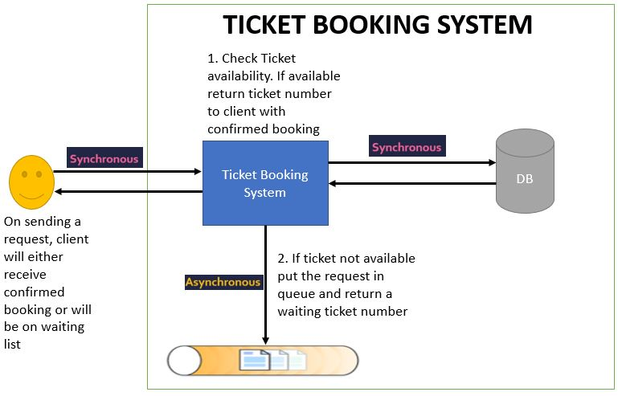
Real time systems
Real time systems usually have a combination of syschronous and ascynchronous communication

Slide 8
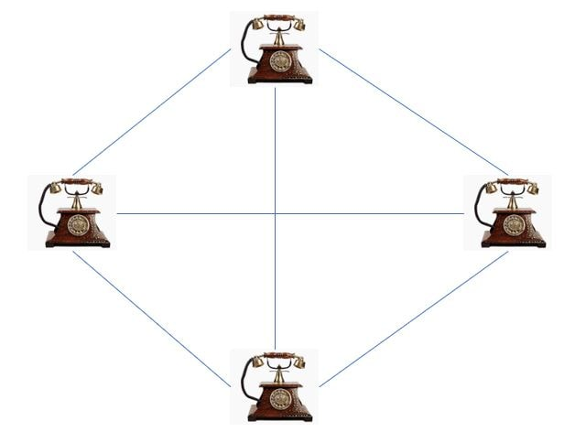
Message Broker
Message Broker - are responsible for establishing connections with various client systems.
Let us consider role of Message Broker in a telecom system. Suppose initially there is no message broker. Then each telephone connection will have a direct line with all other telephone connections.

Slide 9
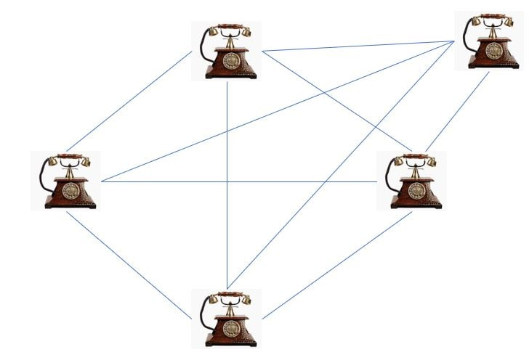
Message Broker(2)
Suppose tomorrow if another telephone connection needs to be added, then all existing telephone connections will need to get a direct line with this new telephone connection. As more connections are added this will get more complicated.

Slide 10
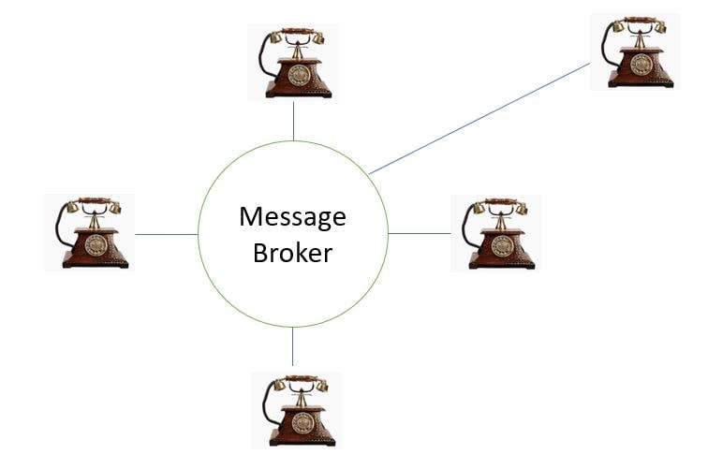
Message Broker(3)
With Message broker all connections are registered with Message Broker. So all connections only need to connect to the message broker. It will automatically route the message to the correct client based on some message configuration.

Slide 11
Rabbit mq installation ubuntu
echo "deb http://www.rabbitmq.com/debian/ testing main" | sudo tee -a /etc/apt/sources.list
echo "deb http://packages.erlang-solutions.com/ubuntu wheezy contrib" | sudo tee -a /etc/apt/sources.list
wget http://packages.erlang-solutions.com/ubuntu/erlang_solutions.asc
sudo apt-key add erlang_solutions.asc
sudo apt-get update
sudo apt-get -y install erlang erlang-nox
sudo apt-get -y --force-yes install rabbitmq-server

Slide 12
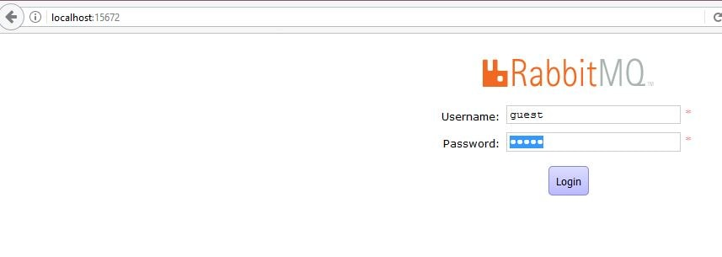
Rabbit mq installation ubuntu(2)
# Enable the web interface
sudo rabbitmq-plugins enable rabbitmq_management
sudo service rabbitmq-server restart
ss -tunelp | grep 1567
sudo service rabbitmq-server start
sudo service rabbitmq-server stop
http://localhost:15672
https://stackoverflow.com/questions/8808909/simple-way-to-install-rabbitmq-in-ubuntu

Slide 13
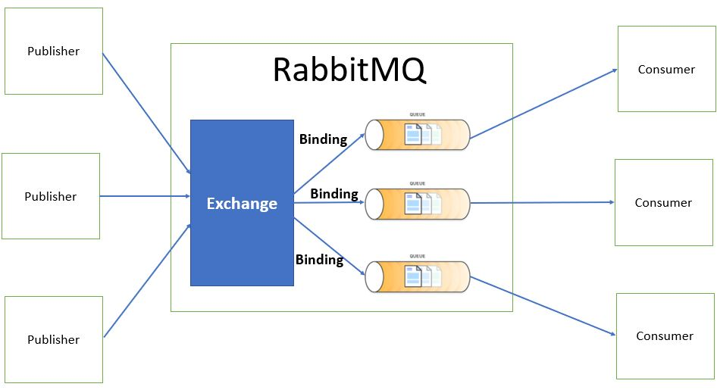
RabbitMQ Messaging Flow
When using RabbitMQ the publisher never directly sends a message to a queue. Instead, the publisher sends messages to an exchange. Exchange is responsible for sending the message to an appropriate queue based on routing keys, bindings and header attributes. Exchanges are message routing agents which we can define and bindings are what connects the exchanges to queues. So in all our examples we will be creating first a Queue and Exchange, then bind them together.

Slide 14
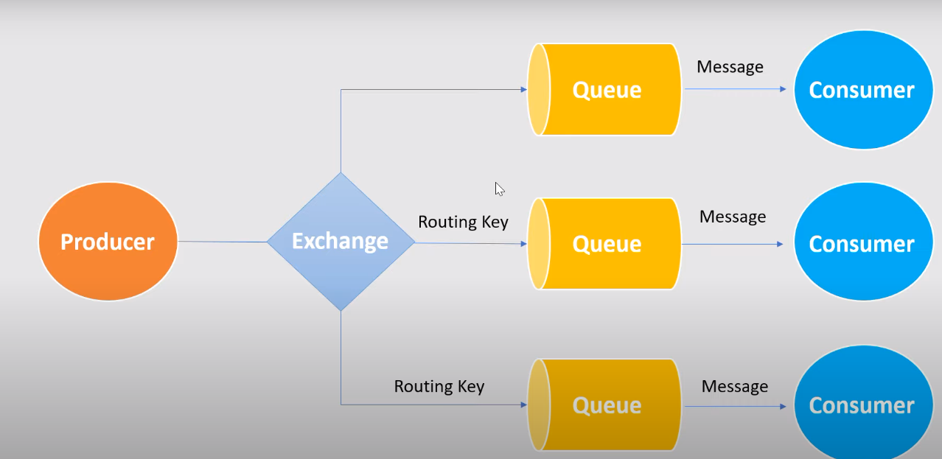
Spring boot rabbitMQ hello world
Create spring boot project with web, ampq dependencies

Slide 15
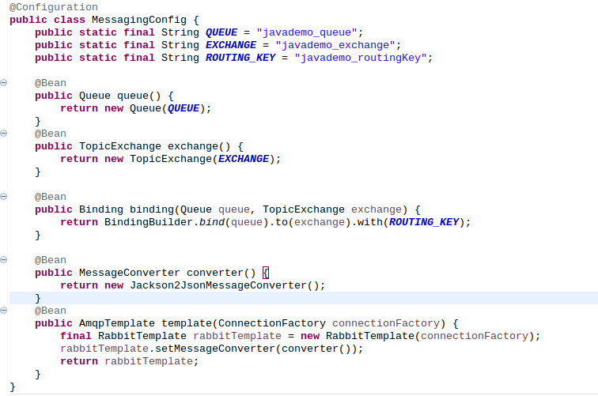
Configuration rabbitmq

Slide 16
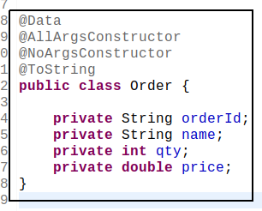
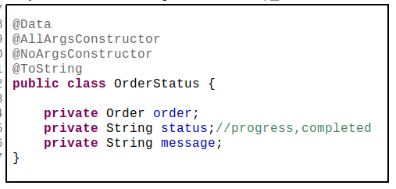
Request and response objects

Slide 17
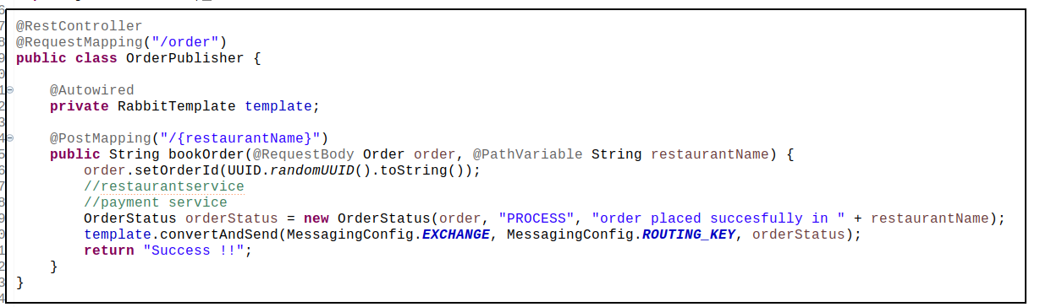
Order Producer

Slide 18
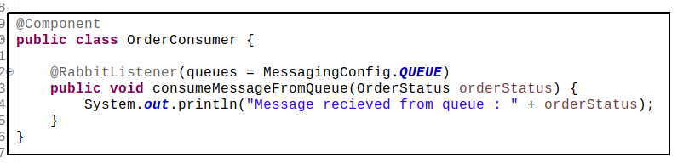
Order Consumer

Slide 19
RabbitMQ types of Exchanges
With RabbitMQ we have the following types of Exchanges-
Direct Exchange
Fanout Exchange
Topic Exchange
Header Exchange

Slide 20
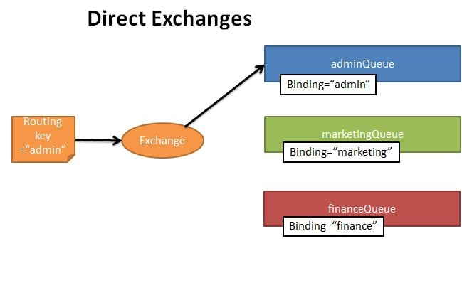
Direct Exchange
Based on the routing key a message is sent to the queue having the same routing key specified in the binding rule. The routing key of exchange and the binding queue have to be an exact match. A message is sent to exactly one queue.

Slide 21
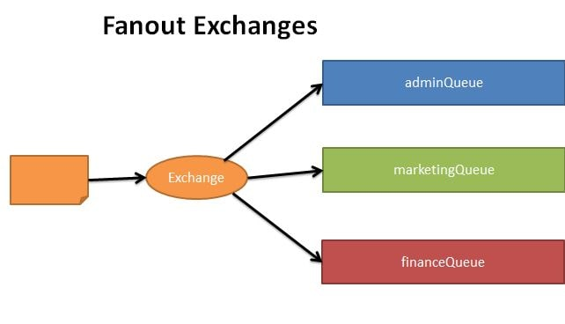
Fanout Exchange
The message is routed to all the available bounded queues. The routing key if provided is completely ignored. So this is a kind of publish-subscribe design pattern.

Slide 22
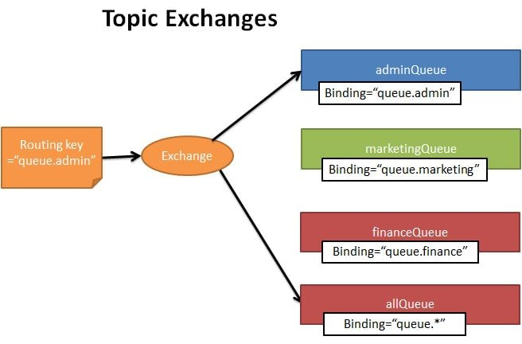
Topic Exchange
Here again the routing key is made use of. But unlike in direct exchange type, here the routing key of the exchange and the bound queues should not necessarily be an exact match. Using regular expressions like wildcard we can send the exchange to multiple bound queues.

Slide 23
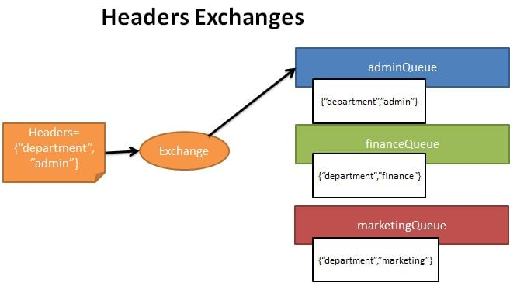
Header Exchange
In this type of exchange the routing queue is selected based on the criteria specified in the headers instead of the routing key. This is similar to topic exchange type, but here we can specify complex criteria for selecting routing queues.

Slide 24
Direct exchange in details

Slide 25
Direct Exchange
Based on the routing key a message is sent to the queue having the same routing key specified in the binding rule. The routing key of exchange and the binding queue have to be an exact match. A message is sent to exactly one queue.

Slide 26
Direct Exchange
Create the RabbitMQDirectConfig as follows-
Create Queues named - marketingQueue, adminQueue, financeQueue
Create a DirectExchange named - direct-exchange
Create Bindings for each of the queue with the DirectExchange specifying the binding key

Slide 27
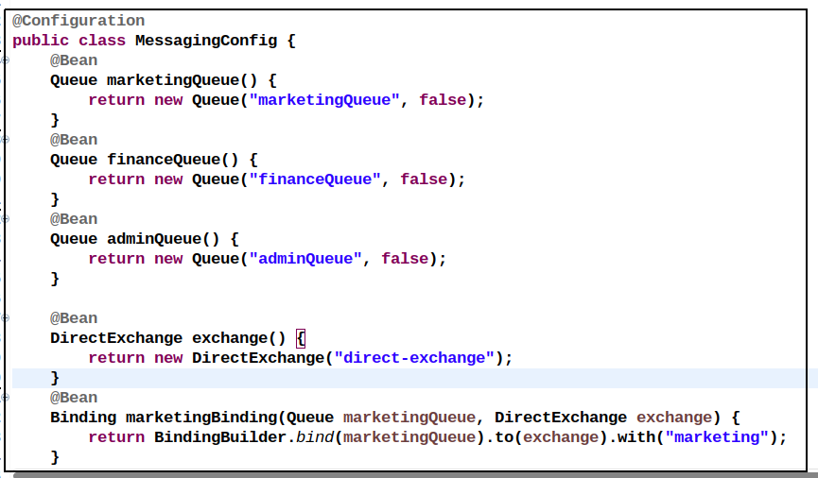
Direct Exchange config

Slide 28
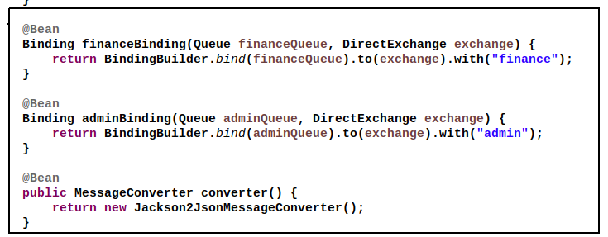
Direct Exchange config

Slide 29
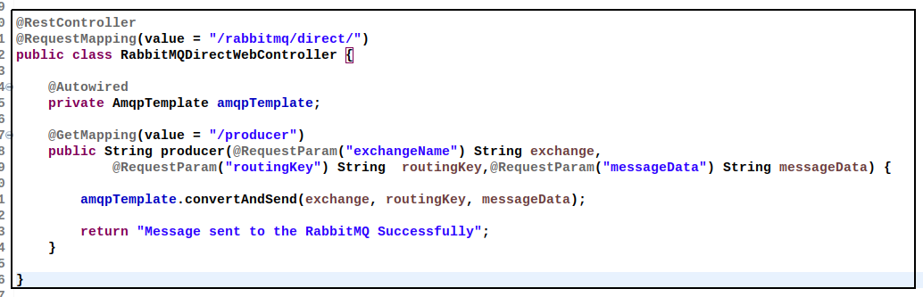
Direct Exchange controller
We send the message using the url
- http://localhost:8080/rabbitmq/direct/producer?exchangeName=direct-exchange&routingKey=admin&messageData=HelloWorld
we will be specifying the following
exchange name= "direct-exchange"
routing key ="admin"
message to sent to queue = "HelloWorld"

Slide 30
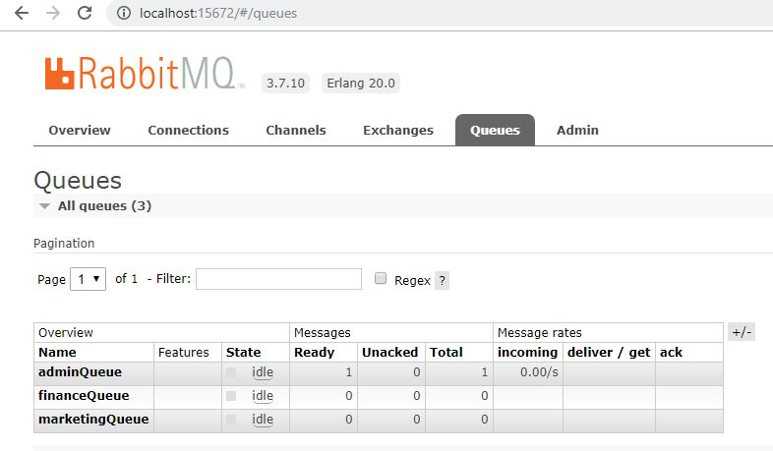
Direct Exchange Queues
We can see that queues named marketingQueue, adminQueue and financeQueue are created. Also a message has been sent to the adminQueue

Slide 31
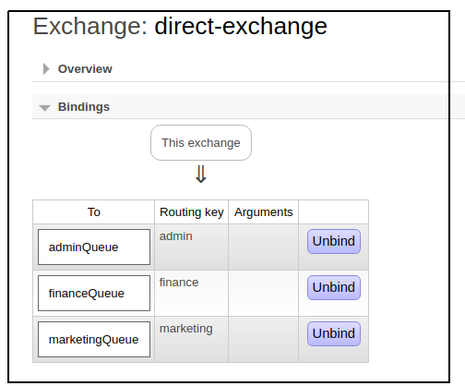
Direct Exchange Queues
An exchange named direct-exchange is created with following bindings

Slide 32
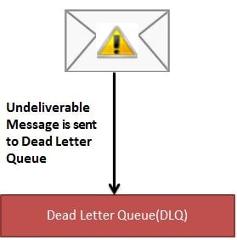
Retry and Error Handling
If exception still exists after maximum retries then put message in a dead letter queue where it can be analyzed and corrected later.
What is a Dead Letter Queue?
  In English vocabulary Dead letter mail is an undeliverable mail that cannot be delivered to the addressee.
  A dead-letter queue (DLQ), sometimes which is also known as an undelivered-message queue, is a holding queue for messages that cannot be delivered to their destinations due to some reason or other.

Slide 33
Retry and Error Handling
In message queueing the dead letter queue is a service implementation to store messages that meet one or more of the following failure criteria:
Message that is sent to a queue that does not exist.
Queue length limit exceeded.
Message length limit exceeded.
Message is rejected by another queue exchange.
Message reaches a threshold read counter number, because it is not consumed. Sometimes this is called a "back out queue".

Slide 34
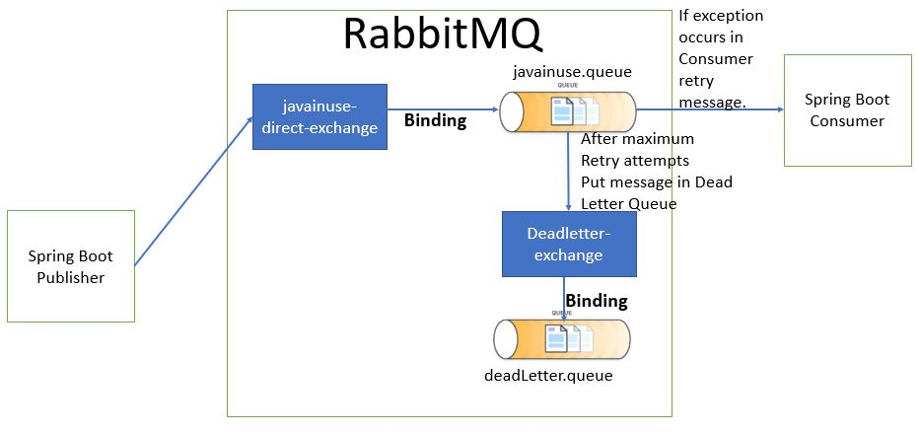
Retry and Error Handling
Spring Boot Producer Module - It will produce a message and put it in RabbitMQ queue. It will also be responsible for creating the required queues including the dead letter queue.
Spring Boot Consumer Module - It will consume a message from RabbitMQ queue. We will be throwing an exception and then retrying the message. After maximum retries it will then be put in dead letter queue.

